Slide 1
Semantic Segmentation
Of the Left Ventricle
Comparison of A.I. Models With Different Design Parameters
TC3007C.502 Penta Tech 11/30/23
Notes:
Fausto

Slide 2
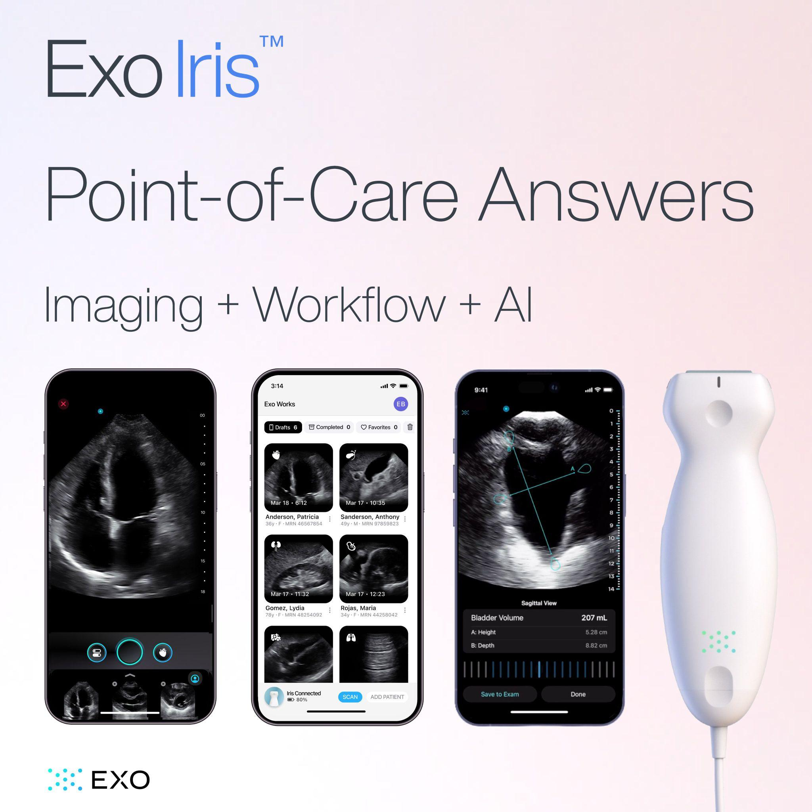
Context
Medical Imaging & Devices Company
Notes:
Fausto

Slide 3
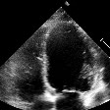
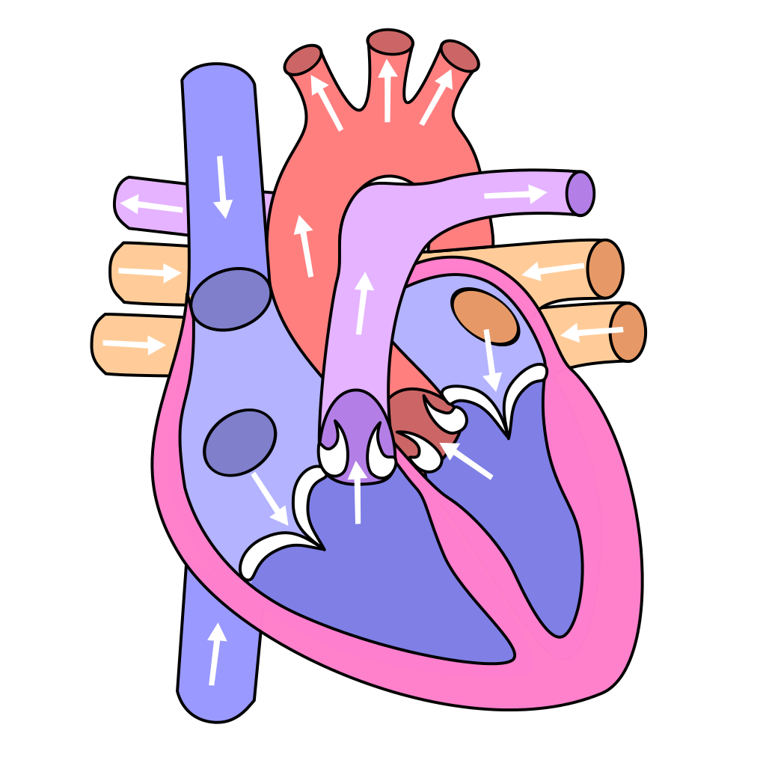
Context
Left Ventricle
Responsible for pumping oxygenated blood to the body (connected to most organ systems)
Assessment of LV systolic functions:
EDV (End-Diastolic Volume): Max. blood volume in ventricle (before contraction)
ESV (End-Systolic Volume): Min. blood volume in ventricle (after contraction)
EF (Ejection Fraction): Percentage of blood pumped out during each contraction
Can be measured with echocardiography
Used to diagnose heart failure
Apical view: Detailed perspective from
the heart’s bottom tip into its chambers
Notes:
Alan

Slide 4
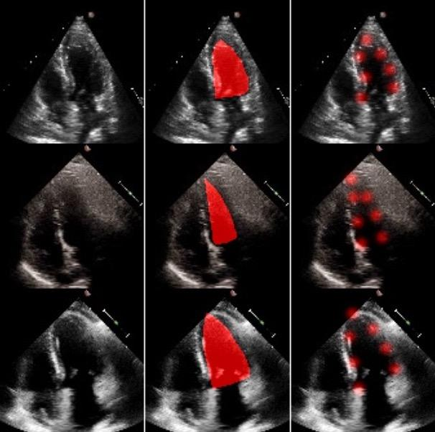
Context
Models
The purpose of this project was to compare between a landmark-based model and a mask-based model
Masks: Labeled pixel regions or objects in an image
Landmarks: Distinctive points on an object used to identify its position
To create a fair comparison, the same architecture and design parameters were used to train the models
Dice Score: Metric generally used to
evaluate the performance of medical
image segmentation models
Measures overlap between predicted
segmentation and the ground truth
Notes:
Fausto

Slide 5
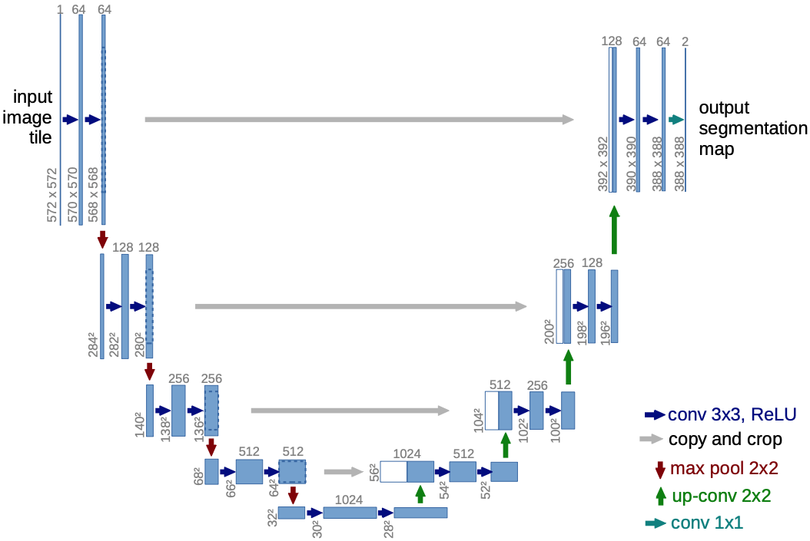
Context
U-Net
Olaf Ronneberger, Philipp Fischer, and Thomas Brox: U-Net: Convolutional Networks for Biomedical Image Segmentation
Often used for segmenting medical images (organs, tumors, or other structures)
Produces detailed and accurate segmentation of structures in various types of computer vision tasks
Can be trained efficiently on limited labeled data (important when acquiring said data
can be challenging)
Notes:
Alan

Slide 6

Dataset
“deidentified set of 10,030 echocardiogram videos”
Notes:
Fausto

Slide 7
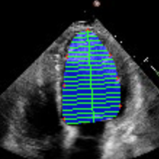
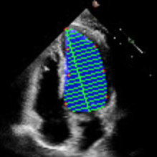
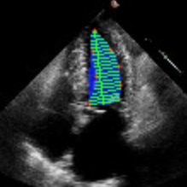
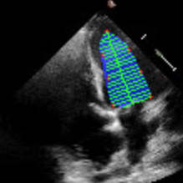
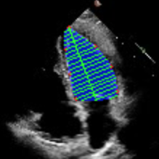
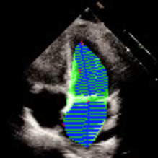
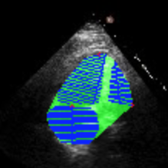
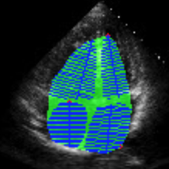
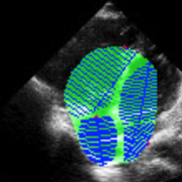
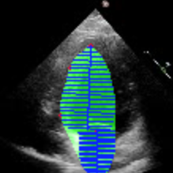
Dataset
Valid data
Invalid data
Notes:
Fausto

Slide 8


Dataset
float64
float16
Images | Shape
Train | (14912, 112, 112, 1)
Val | (2576, 112, 112, 1)
Test | (2552, 112, 112, 1)
Normalized in Grayscale
Notes:
Alan

Slide 9
Dataset
Masks | Shape
Train | (14912, 112, 112, 1)
Val | (2576, 112, 112, 1)
Test | (2552, 112, 112, 1)
Landmarks | Shape
Train | (14912, 112, 112, 7)
Val | (2576, 112, 112, 7)
Test | (2552, 112, 112, 7)
Notes:
Alan

Slide 10
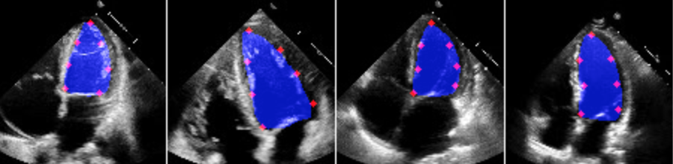
Models
Design Parameters
Same architecture as the one in the original U-Net paper
Same number of epochs and batch size
Same loss function and optimizer
Trained using all available labeled data
Selection of the best model through model checkpoints
Notes:
Fausto

Slide 11
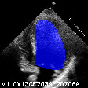
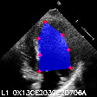
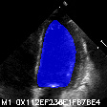
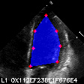
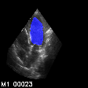
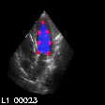
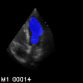
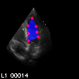
Results
Testing data
“Apical” dataset
Notes:
Fausto

Slide 12
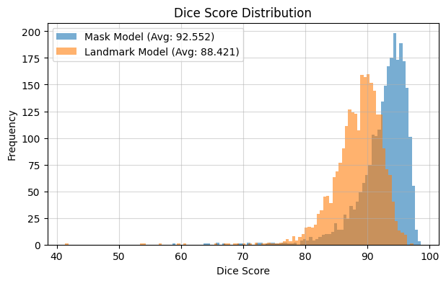
Results
Notes:
Alan

Slide 13
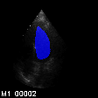
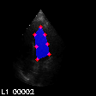
Would changing the input improve performance?
Both models showed clear deficiencies
with the “Apical” dataset
Notes:
Alan

Slide 14
Dataset
float64
float16
Images | Shape
Train | (14912, 112, 112, 3)
Val | (2576, 112, 112, 3)
Test | (2552, 112, 112, 3)
Normalized in RGB
Notes:
Fausto

Slide 15
Models
Design Parameters
Same architecture as the one in the original U-Net paper
Same number of epochs and batch size
Same loss function and optimizer
Trained using all available labeled data
Selection of the best model through model checkpoints
Notes:
Fausto

Slide 16
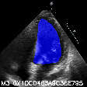
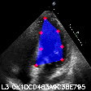
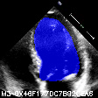
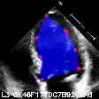
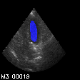
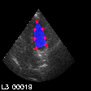
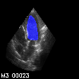
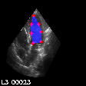
Results
Testing data
“Apical” dataset
Notes:
Alan

Slide 17
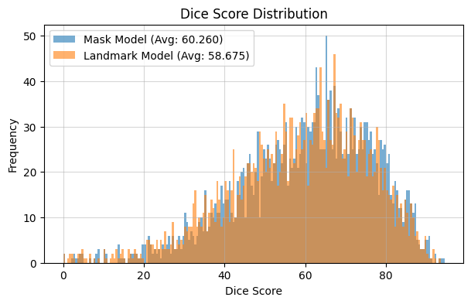
Results
Notes:
Alan

Slide 18
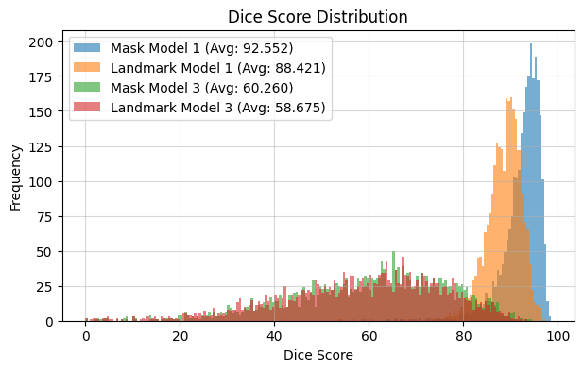
Conclusion
Notes:
Fausto

Slide 19
Conclusion
Further Experimentation
Adding external datasets to current dataset
Using a completely different CNN architecture
Experimenting and fine-tuning with a custom loss functions
Activity | Team Members
Dataset Creation | Alan Vilchis & Fausto Palma
Model Creation | Alan Vilchis, Fausto Palma & Alejandro Pizarro
Model Comparison | Diego Rosas & Héctor Cárdenas
Research Paper | Diego Rosas & Héctor Cárdenas
Presentation | Alejandro Pizarro
Notes:
Fausto

Slide 20
Thank You
Any Questions?
Notes:
Alan

